Slide 1


Normal Distribution
It is also known by other names such as- Gaussian Distribution, Bell shaped Distribution.

Slide 2
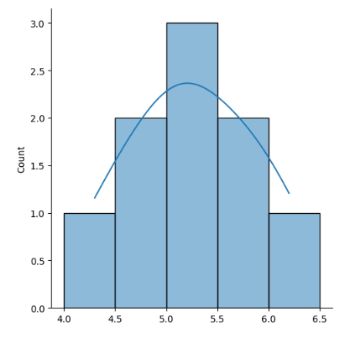
Name | Height
Bob | 6.2
Samay | 5.7
Raj | 4.6
Radha | 5.4
Tarun | 5.9
Ananya | 4.3
Aman | 5.1
Paras | 5.2
Sarita | 4.9
Notes:
If I want to analyze the height of people for clothing store to know which size of clothes require more?

Slide 3
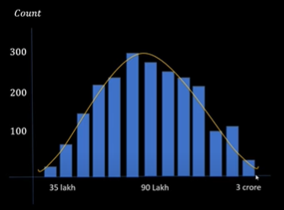
2 Bedroom apartment price in Noida

Slide 4
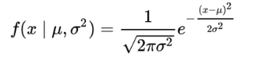
Normal distribution
Normal distribution is a pattern of data where most values cluster around the average (mean), with fewer and fewer values as you move away from the average in either direction.
It is often represented as a bell-shaped curve.
The probability density function (pdf) of an exponential distribution is
Where $μ$ is the mean and $σ$ is the standard deviation.
The shape of the Normal Distribution curve is defined by the mean and standard deviation of the sample; the curve will be centered and symmetric around the mean and stretched by the standard deviation.

Slide 5
Key features of the normal distribution:
mode, median and mean are the same and are together in the centre of the curve
symmetrical shape
there can only be one mode (i.e. there is only one value which is most frequently observed)

Slide 6
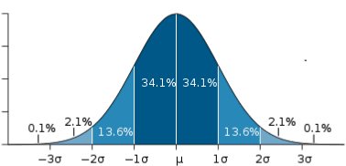
most of the data are clustered around the centre, while the more extreme values on either side of the centre become less rare as the distance from the centre increases
(i.e. About 68% of values lie within one standard deviation (σ) away from the mean; about 95% of the values lie within two standard deviations; and about 99.7% are within three standard deviations. This is known as the empirical rule or the 3-sigma rule.)

Slide 7
What is the probability that a Normal random variable differs from its mean μ by more than σ ?

Slide 8
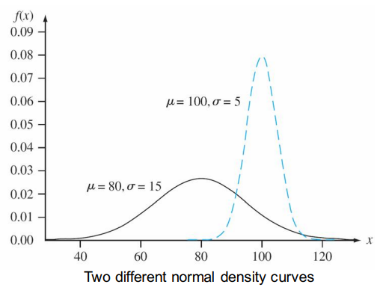

Slide 9
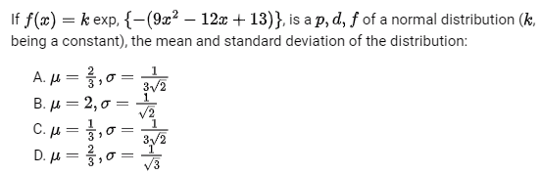
Answer: (A)

Slide 10
Standard Normal Distribution

Slide 11

z score
x = individual value
μ = mean
σ = standard deviation

Slide 12

Standard Normal Distribution –
In the General Normal Distribution, if the Mean is set to 0 and the Standard Deviation is set to 1, then the corresponding distribution obtained is called the Standard Normal Distribution. The Probability Density function now becomes-

Slide 13
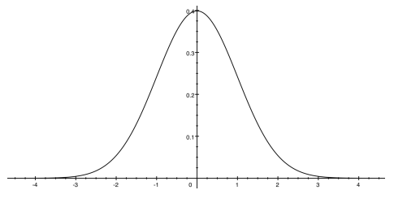
If X is a normal random variable with E(X)= $μ$ and V(X)= $σ$ , the random variable $Z=\frac{X−μ}{σ}$ is a normal random variable with E(Z)=0 and V(Z)=1. That is, Z is a standard normal random variable.

Slide 14
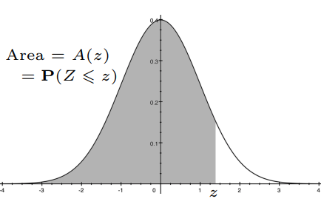

Slide 15
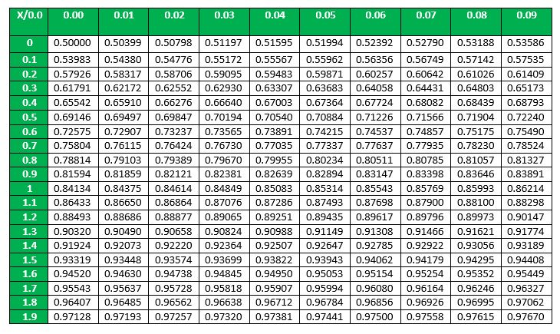

Slide 16
P(Z<1) =
P(Z<0.87) =

Slide 17
P(Z< - 1) =
P(Z>1.5) =

Slide 18
P(Z> - 1) =
P(Z> -1.56) =

Slide 19
P(- 1< Z < 1) =

Slide 20
Example – Suppose that the current measurements in a strip of wire are assumed to follow a normal distribution with a mean of 10 milliamperes and a variance of four (milliamperes)² . What is the probability that a measurement exceeds 13 milliamperes?

Slide 21
GATE ME 2014
A nationalized bank has found that the daily balance available in its saving bank accounts follows a normal distribution with a mean of Rs. 500 and a standard deviation of Rs. 50. The percentage of savings account holders who maintain an average daily balance more than Rs. 500 is _______________.
Answer: 50
Notes:
P(α < Z) = 0.05

Slide 22
GATE CS 2008
Let X be a random variable following normal distribution with mean +1 and variance 4. Let Y be another normal variable with mean -1 and variance unknown If P(X <=-1) = P(Y >=2). the standard deviation of Y is (A) 3 (B) 2 (C) sqrt(2) (D) 1
Answer: (A)

Slide 23

The distribution of marks scored by a large class in an exam can be represented as a normal distribution with mean μ and standard deviation σ . In a follow-up exam in the same class, everyone scored 5 marks more than their respective score in the earlier exam. For this follow-up exam. the distribution of marks can be represented as a normal distribution with mean μ₂ and standard deviation σ₂. Which one of the following is correct?
Answer: (D)

Slide 24
T Distribution
The t-distribution is used in statistics to estimate the population parameters for small sample sizes or undetermined variances.
It is also referred to as the Student’s t-distribution.
The t-distribution is similar to the normal distribution, but generally has fatter tails.

Slide 25
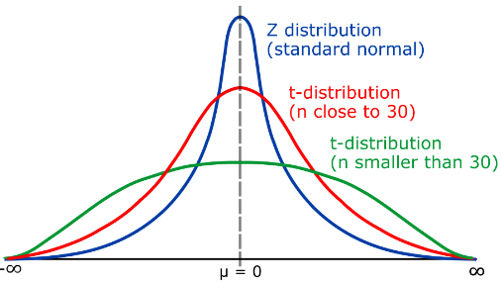
Notes:
Fatter tails allows to higher dispersion of variables, as there is more uncertainty. i.e. T-distributions have a greater chance for extreme values than normal distributions

Slide 26
Fatter tails allows to higher dispersion of variables, as there is more uncertainty.
i.e. T-distributions have a greater chance for extreme values than normal distributions
n – size of sample space
(n-1) – degree of freedom

Slide 27
Student’s t distribution is the sampling distribution of the t-statistic.
The values of the t-statistic is given by:
$$t=\frac{\overline{x}−μ}{s/{\sqrt{n}}}$$
where,
t = t score
$\overline{x}$ = sample mean,
μ = population mean,
s = standard deviation of the sample,
n = sample size
As z table we have t table also, we will discuss that in statistics.

Slide 28
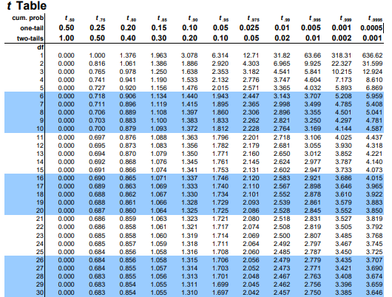

Slide 29
Basics of Statistics

Slide 30
GATE DA Sample Paper 2024
X is a uniform distribution random variable with support in [-2, 2] U [99.5, 100.5]. The mean of X is _______

Slide 31
Population:
Population is the entire group you want to draw conclusions about.
Examples
The number of citizens living in the State of Rajasthan
All the chess players who have FIDE rating
the number of planets in the entire universe
The types of candies and chocolates are made in India.

Slide 32
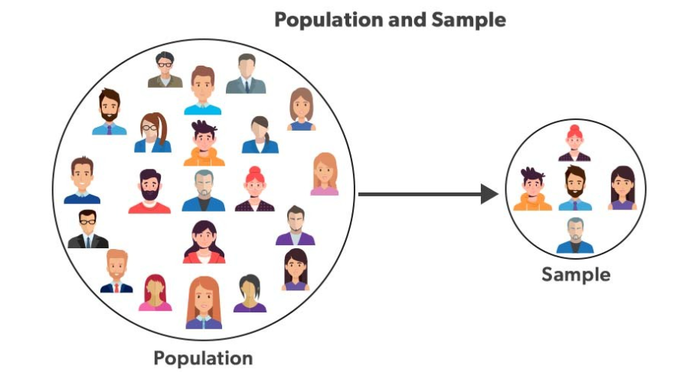
Sample:
The sample is an unbiased subset of the population in which we represent the whole data.

Slide 33
Random Sample: When each number/member from the population has an equal chance of being selected.

Slide 34
The Branches of Statistics
Two branches, descriptive statistics and inferential statistics, comprise the field of statistics.
Descriptive Statistics
The branch of statistics that focuses on collecting, summarizing, and presenting a set of data.
EXAMPLES
The average age of citizens who voted for the winning candidate in the last presidential election, the average length of all books about statistics, the variation in the weight of 100 boxes of cereal selected from a factory’s production line.

Slide 35
Inferential Statistics
The branch of statistics that analyzes sample data to draw conclusions about a population.
EXAMPLE A survey that sampled 2,001 full- or part-time workers ages 50 to 70, conducted by the American Association of Retired Persons (AARP), discovered that 70% of those polled planned to work past the traditional mid60s retirement age.
Inferential statistic could be used to draw conclusions about the population of all workers ages 50 to 70.

Slide 36
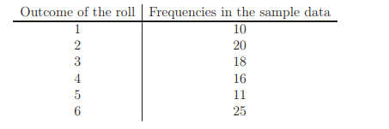
Example
Consider event of tossing dice. The dice is rolled 100 times and the results are forming the sample data.
Descriptive statistics is used to grouping the sample data to the following table
Inferential statistics can now be used to verify whether the dice is a fair or not.

Slide 37
The features of the population under investigation can be summarized by numerical parameters.
These population parameters are unknown and sample statistics are used to make inference about them.
(Parameters and Statistics)
A parameter is an unknown numerical summary of the population.
A statistic is a known numerical summary of the sample which can be used to make inference about parameters.

Slide 38
Central Limit Theorem for mean

Slide 39
If we collect samples of size n and n is "large enough," calculate each sample’s mean, and create a histogram of those means, then the resulting histogram will tend to have an approximate normal bell shape.
It does not matter what the distribution of the original population is, or whether you even need to know it. The important fact is that the sample means (averages) and the sums tend to follow the normal distribution
Notes:
Why are we so concerned with averages?
Two reasons are that they give us a middle ground for comparison and they are easy to calculate.

Slide 40
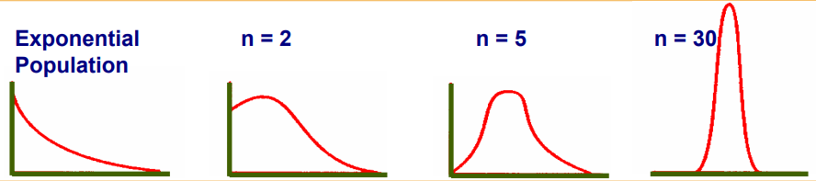
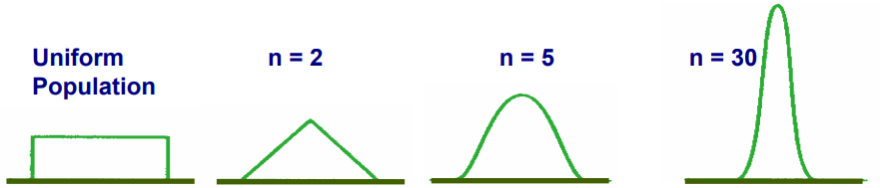
Notes:
Why are we so concerned with averages?
Two reasons are that they give us a middle ground for comparison and they are easy to calculate.

Slide 41
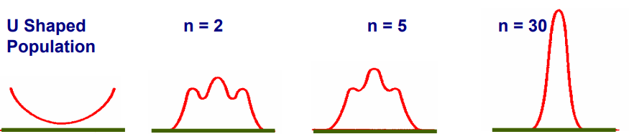
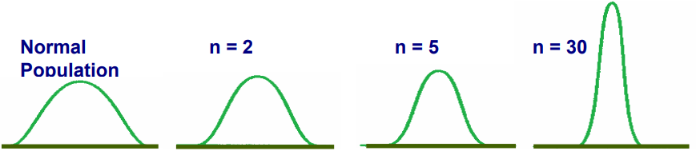
Notes:
Why are we so concerned with averages?
Two reasons are that they give us a middle ground for comparison and they are easy to calculate.

Slide 42


Central Limit Theorem for mean
Suppose X is a random variable with a distribution that may be known or unknown (it can be any distribution).
suppose:
µ = the mean of X
σ = the standard deviation of X
If you draw random samples of size n, then as n increases, the random variable$\overline{X}$which consists of sample means, tends to be normally distributed and

Slide 43
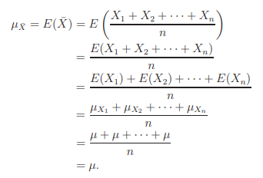

Slide 44
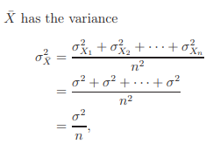

Slide 45
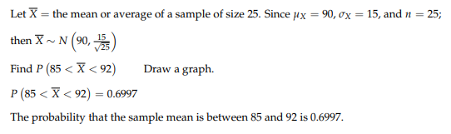
An unknown distribution has a mean of 90 and a standard deviation of 15. Samples of size n = 25 are drawn randomly from the population.
Find the probability that the sample mean is between 85 and 92.

Slide 46
Example Consider a normal population with mean µ = 82 and standard deviation σ = 12.
If a random sample of size 64 is selected, what is the probability that the sample mean $\overline{X}$ will lie between 80.8 and 83.2?
With a random sample of size 100, what is the probability that the sample mean $\overline{X}$ will lie between 80.8 and 83.2?

Slide 48
An electrical firm manufactures light bulbs that have a length of life that is approximately normally distributed, with mean µ (expected value) equal to 800 hours and a standard deviation of 40 hours. Find the probability that a random sample of 16 bulbs will have an average life of less than 775 hours?
Answer: 0.0062

Slide 49
Central Limit Theorem for sum

Slide 50


Central Limit Theorem for sum
Suppose X is a random variable with a distribution that may be known or unknown (it can be any distribution).
suppose:
µ = the mean of X
σ = the standard deviation of X
If you draw random samples of size n, then as n increases, the random variable
which consists of total of n observations, tends to be normally distributed and

Slide 51
EXAMPLE A large freight elevator can transport a maximum of 9800 pounds. Suppose a load of cargo containing 49 boxes must be transported via the elevator. Experience has shown that the weight of boxes of this type of cargo follows a distribution with mean µ = 205 pounds and standard deviation σ = 15 pounds. Based on this information, what is the probability that all 49 boxes can be safely loaded onto the freight elevator and transported?
We are given n = 49, µ = 205, σ = 15.
The elevator can transport up to 9800 pounds. Therefore these 49 boxes will be safely transported if they weigh in total less than 9800 pounds.

Slide 52

EXAMPLE From past experience, it is known that the number of tickets purchased by a student standing in line at the ticket window for the football match of UCLA against USC follows a distribution that has mean µ = 2.4 and standard deviation σ = 2.0. Suppose that few hours before the start of one of these matches there are 100 eager students standing in line to purchase tickets. If only 250 tickets remain, what is the probability that all 100 students will be able to purchase the tickets they desire?
We are given that µ = 2.4, σ = 2, n = 100. There are 250 tickets available, so the 100 students will be able to purchase the tickets they want if all together ask for less than 250 tickets.

Slide 54
Confidence Interval
The main idea is to estimate properties of a population based on properties of a sample.

Slide 55
Estimators of a Population
A Point estimate is a single value that best describes the population of interest
An Interval estimate provides a range of values that best describes the population

Slide 56
Point Estimate
Single value that best describes the population of interest
Sample mean is most common point estimate
But it gives no indication of how accurate the estimation really is

Slide 57
Interval Estimation
To deal with uncertainty, we can use an interval estimate.
Interval estimates may be in the form of a confidence interval whose purpose is to bound population parameters such as the mean, the proportion, the variance, and the standard deviation.

Slide 58
Confidence Interval Estimates:
In simple terms, Confidence Interval is a range where we are certain that true value exists.
But this is the same as the probability that the population mean lies within a certain interval of a sample.
Thus, we can determine how confident we are that the population mean lies within a certain interval of a sample mean.
Confidence Level:
The confidence level describes the uncertainty associated with a sampling method.

Slide 59
For example, let’s suppose you were surveying an average height of men in a particular city. To find that, you set a 95% confidence level and find that the 95% confidence interval is (168,182). That means if you repeated this over and over, 95 percent of the time the height of a man would fall somewhere between 168 cm and 182 cm.

Slide 60
Generally, 100(1 − α)% confidence interval
95% confidence interval means α = 0.05 i.e. There is 5% chances of error.

Slide 61
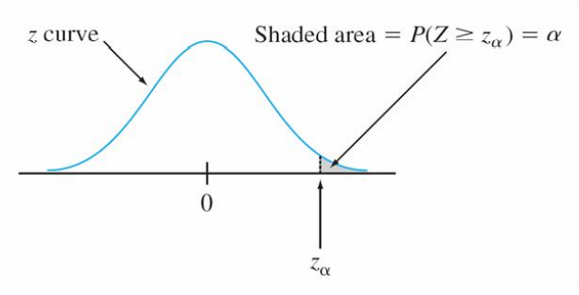
Notation: z_{α}
In statistical inference, we need the z values that give certain tail areas under the standard normal curve.
z_{α} will denote the z value for which α of the area under the z curve lies to the right of z_{α}.

Slide 62
What is the z value for a 90, 95, and 99 percent confidence interval?

Slide 63
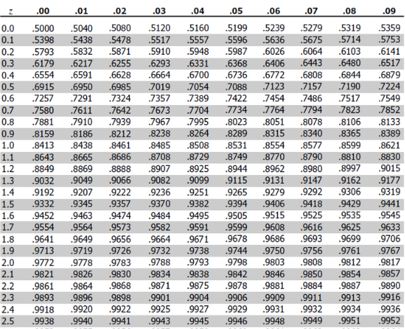

Slide 64

Constructing a confidence interval involves 4 steps.
Step 1: Identify the sample problem. Choose the statistic (like sample mean, etc) that you will use to estimate population parameter.
Step 2: Select a confidence level. (Usually, it is 90%, 95% or 99%)
Step 3: Find the margin of error. (Usually given) If not given, use the following formula:- Margin of error = Critical value * Standard deviation
Step 4: Specify the confidence interval. The uncertainty is denoted by the confidence level. And the range of the confidence interval is defined by

Slide 65
We use z-distribution when the sample size n>30. Z-test is more useful when the standard deviation is known.
Consider the following example. A random sample of 50 adult females was taken and their RBC count is measured. The sample mean is 4.63 and the standard deviation of RBC count is 0.54. Construct a 95% confidence interval estimate for the true mean RBC count in adult females.
Notes:
(4.480,4.780)

Slide 66

Example. A sample of 25 Valencia oranges weighed an average (mean) of 10 oz per orange. The standard deviation of the population of weights of Valencia oranges is 2 oz. Find a 95% confidence interval (CI) for the population mean.

Slide 67
Example. A random sample of 100 batteries has a mean lifetime of 15 hours. Suppose the standard deviation for battery life in the population of all batteries is 2 hours. Give a 95% CI for the mean battery life.

Slide 68
What can we learn from the formula?
As n increases, the width of the CI DECREASES
As σ increases, the width of the CI INCREASES
As the confidence level increases, z ∗ INCREASES , so the width INCREASES

Slide 69
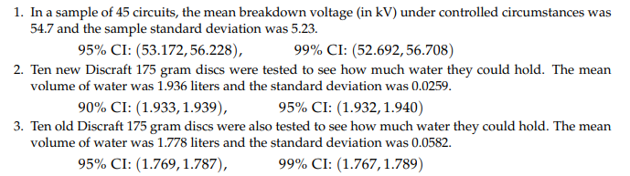

Slide 70

Thank you

Slide 71
Question Suppose that you have a sample of 100 values from a population with mean µ = 500 and with standard deviation σ = 80. What is the probability that the sample mean will be in the interval (490, 510)?

Slide 72


A research worker wishes to estimate the mean of a population using a sample large enough that the probability will be 0.95 that the sample mean will not differ from the population mean by more than 25% of the standard deviation. How large a sample should he take?

Slide 73
Question The amount of mineral water consumed by a person per day on the job is normally distributed with mean 19 ounces and standard deviation 5 ounces. A company supplies its employees with 2000 ounces of mineral water daily. The company has 100 employees. Find the probability that the mineral water supplied by the company will not satisfy the water demanded by its employees.

